Slide 1


CUDA 101
X
CUDA 101
CUDA 101

Slide 2
About Me
Hello I am Joyen an upcoming SoC Design Engineer @Incore_Semiconductors
Co-Founder Hyprthrd
GDSC-Lead’22
Below are some of my research interest:
Computer Architecture
SoC (System on Chip)
HW/SW co-design
Hardware Accelerator

Slide 3
But why GPU?
AI AI AI AI …………..
Evergrowing demand for HPC
Gaming ofc!
Data center
And a lot more. . . . !

Slide 4
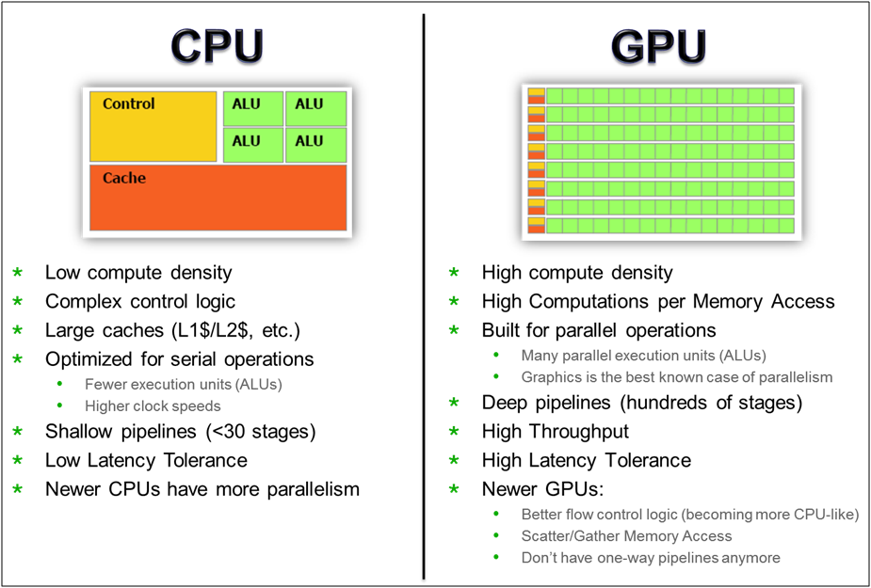
CPU Vs GPU

Slide 5
CUDA Programming Flow
Initialization of data form CPU
Transfer data form CPU context to GPU context
Kernel launch with needed grid/block size
Transfer results back to CPU context from GPU context
Reclaim the memory from both CPU and GPU

Slide 6
Hello CUDA World!
#include "cuda_runtime.h"
#include "device_launch_parameters.h"
#include <stdio.h>
//Device Code
__global__ void hello_cuda(){
printf("Hello from CUDA world \n");
}
//Host code
int main(){
//kernel launch parameters
hello_cuda<< <1,10>> > (); // async call
printf("Hello from CPU \n");
cudaDeviceSynchronize();
cudaDeviceReset();
return 0;
}
Kernel_name<< <number_of_blocks,thread_per_block>> > ()
kernel_name<< < Dg, Db, Ns, S >> >([kernel arguments]);
`Dg` is of type `dim3` and specifies the dimensions and size of the grid
`Db` is of type `dim3` and specifies the dimensions and size of each thread block
`Ns` is of type `size_t` and specifies the number of bytes of shared memory that is dynamically allocated per thread block for this call in addition to statically allocated memory. `Ns` is an optional argument that defaults to 0.
`S` is of type `cudaStream_t` and specifies the stream associated with this call. The stream must have been allocated in the same grid where the call is being made. `S` is an optional argument that defaults to the NULL stream

Slide 7
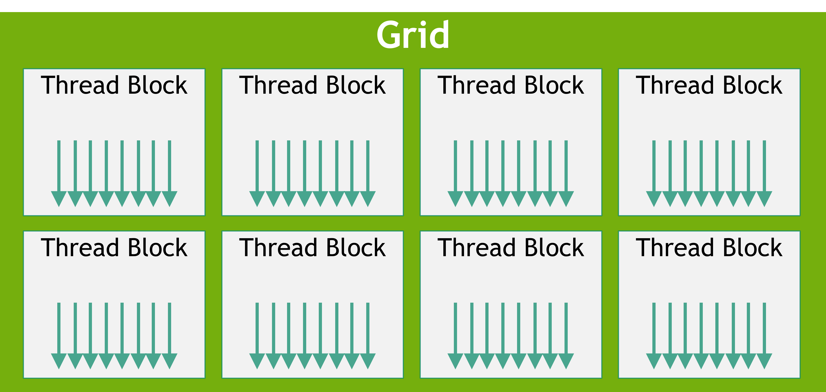
Grids and Blocks
Grid is the collection of all the threads launch for a kernel, in the above code we had 20 threads. A three dimensional view of the grid can be visualised using the Cartesian coordinate system.
Threads in a grid is organized in to groups called thread blocks, these thread blokes allows the CUDA toolkit to synchronise and manage workload without heavy performance penalties.
Kernel launch parameters tells the compiler on how much blocks exist and the number of threads per block.

Slide 8

Kernel Launch Parameters
The kernel launch takes four parameters but for now we will go ahead with two, now like how we did previously if we use integer we can specify only one dimension only. we use #dim3data type to declare a three dimensional variable.
dim3 is a vector type which in 1 by default, to access the individual values use the below.
dim3 variable_name(X, Y, Z);
Limitations:
For block_size is that we can maximum have 1024 for X and Y direction and 64 for the Z direction* Y* Z <= 1024The limitation for the number of thread blocks in each dimension is that you can maximum have 2^32 - 1 in x direction, 65536 threads in other dimension.
variable_name.x
variable_name.y
variable_name.z
Example: Lets say we need to launch the hello_world kernel with one dimensional grid with 32 thread arranged into 8 thread blocks, where each block having 4 threads in x dimension arrangement of the grid would look like this. This can be represented as:

Slide 9
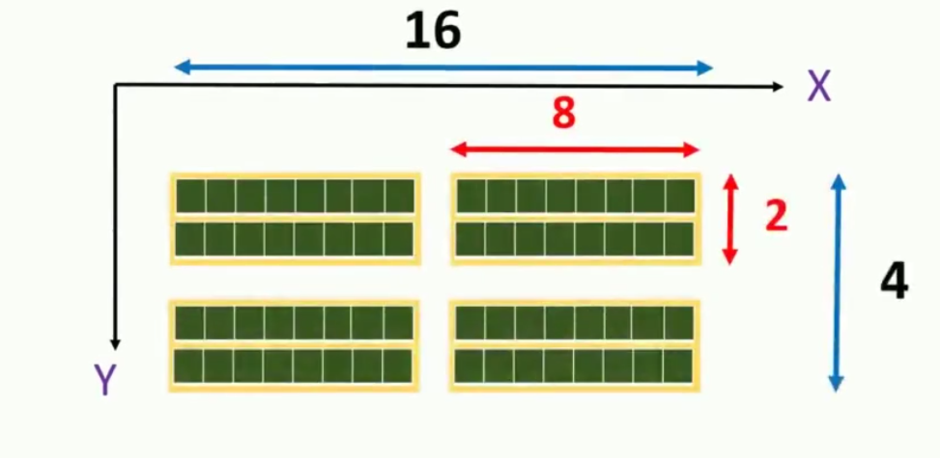
Grid and Blocks
Example 2: Now try creating the following shown below. A 2D grid, with total of 64 threads arranged in 16 threads in x dimension and 4 threads in y dimension. Each thread block will have 8 threads in x dimension and 2 thread in y dimension.

Slide 10
Grids and Blocks
#include "cuda_runtime.h"
#include "device_launch_parameters.h"
#include <stdio.h>
//Device Code
__global__ void hello_cuda(){
printf("Hello from CUDA world \n");
}
//Host code
int main(){
//kernel launch parameters
int nx, ny;
nx = 16;
ny = 4;
dim3 block(8,2,1);
dim3 grid(nx /block.x, ny/block.y);
hello_cuda<<<grid, block>>>();
cudaDeviceSynchronize();
cudaDeviceReset();
return 0;
}
#include "cuda_runtime.h"
#include "device_launch_parameters.h"
#include <stdio.h>
//Device Code
__global__ void hello_cuda(){
printf("Hello from CUDA world \n");
}
//Host code
int main(){
//kernel launch parameters
dim3 block(8,2,1);
dim3 grid(2,2,1);
hello_cuda<<<grid, block>>>();
cudaDeviceSynchronize();
cudaDeviceReset();
return 0;
}

Slide 11
Organization of thread in a CUDA program
CUDA runtime uniquely initialised threadIdx variable for each thread depending on where that particular thread is located in the thread block. threadIdx is a #dim3 type variable
A
B
C
D
E
F
G
H
Thread Name | ThreadIdx.X | ThreadIdx.Y | ThreadIdx.Z
A | 0 | 0 | 0
B | 1 | 0 | 0
C | 2 | 0 | 0
D | 3 | 0 | 0
E | 4 | 0 | 0
F | 5 | 0 | 0
G | 6 | 0 | 0
H | 7 | 0 | 0
Example-1: consider a 1-D grid with 1 thread block with 8 threads

Slide 12
Organization of thread in a CUDA program
A
B
C
D
E
F
G
H
Example-2: consider a 1-D grid with 2 thread block with 8 threads
Thread Name | ThreadIdx.X | ThreadIdx.Y | ThreadIdx.Z
A | 0 | 0 | 0
B | 1 | 0 | 0
C | 2 | 0 | 0
D | 3 | 0 | 0
E | 0 | 0 | 0
F | 1 | 0 | 0
G | 2 | 0 | 0
H | 3 | 0 | 0

Slide 13
Organization of thread in a CUDA program
P
Q
R
S
Thread Name | ThreadIdx.X | ThreadIdx.Y | ThreadIdx.Z
P | 0 | 0 | 0
Q | 2 | 0 | 0
R | 1 | 0 | 0
S | 3 | 0 | 0
T | 0 | 0 | 0
U | 2 | 0 | 0
V | 0 | 0 | 0
X | 3 | 0 | 0
T
U
V
X
Example-3: consider a 1-D grid with 4 thread block with 4 threads per block as shown below.

Slide 14
Organization of thread in a CUDA program
X
P
Y
Q
Thread Name | ThreadIdx.X | ThreadIdx.Y | ThreadIdx.Z
P | 0 | 0 | 0
Q | 2 | 1 | 0
R | 0 | 0 | 0
S | 3 | 1 | 0
T | 1 | 0 | 0
U | 0 | 1 | 0
X | 1 | 0 | 0
Y | 1 | 1 | 0
R
T
S
U
Example-4: consider a 1-D grid with 4 thread block with 8 threads per block as shown below.

Slide 15
Organization of thread in a CUDA program
#include "cuda_runtime.h"
#include "device_launch_parameters.h"
#include <stdio.h>
//Device Code
__global__ void print_thread() {
printf("x: %d y: %d z: %d \n", threadIdx.x, threadIdx.y, threadIdx.z);
}
//Host code
int main() {
int nx, ny;
nx = 16;
ny = 16;
//kernel launch parameters
dim3 block(8, 8);
dim3 grid(nx/block.x, ny/block.y);
print_thread << <grid, block >> > (); // async call
printf("Hello from CPU \n");
cudaDeviceSynchronize(); cudaDeviceReset();
return 0;
}
Example-5: Lets code a CUDA program that is going to launch a 2-D grid which has 256 threads arranged into 2 thread blocks in x-dimension and y-dimension. So we will have 16 threads per block with 8 thread in x and y-dimension.

Slide 16
Organization of thread in a CUDA program
A
B
C
D
E
F
G
H
Example-2: consider a 1-D grid with 2 thread block with 8 threads
Thread Name | blockIdx.X | blockIdx.Y | blockIdx.Z
A | 0 | 0 | 0
B | 0 | 0 | 0
C | 0 | 0 | 0
D | 0 | 0 | 0
E | 1 | 0 | 0
F | 1 | 0 | 0
G | 1 | 0 | 0
H | 1 | 0 | 0

Slide 17
Organization of thread in a CUDA program
P
Q
R
S
Thread Name | blockIdx.X | blockIdx.Y | blockIdx.Z
P | 0 | 0 | 0
Q | 0 | 0 | 0
R | 1 | 0 | 0
S | 1 | 0 | 0
T | 0 | 1 | 0
U | 0 | 1 | 0
V | 1 | 1 | 0
X | 1 | 1 | 0
T
U
V
X
Example-3: consider a 1-D grid with 4 thread block with 4 threads per block as shown below.

Slide 18
Organization of thread in a CUDA program
X
P
Thread Name | blockIdx.X | blockIdx.Y | blockIdx.Z
P | 1 | 0 | 0
Q | 1 | 0 | 0
R | 0 | 1 | 0
S | 0 | 1 | 0
T | 1 | 1 | 0
U | 1 | 1 | 0
X | 0 | 0 | 0
Y | 0 | 0 | 0
Y
Q
R
T
S
U
Example-4: consider a 1-D grid with 4 thread block with 8 threads per block as shown below.

Slide 19
Organization of thread in a CUDA program
blockDim
The blockDim variable consist number of threads in each dimension of a thread block. Notice all the thread block in a grid have same block size, so this variable value is same for all the threads in a grid.
blockDim is a #dim3 type variable.
gridDim
The #gridDim variable consists number of thread blocks in each dimension of a grid.
gridDim is a #dim type variable.
The blockDim.x is going to be 4 and the blockDim.y is going to be 2.
The gridDim.x is going to be 3 and the gridDim.y is going to be 2.

Slide 20
Organization of thread in a CUDA program
#include "cuda_runtime.h"
#include "device_launch_parameters.h"
#include <stdio.h>
//Device Code
__global__ void print_details() {
printf("blockIdx x: % d y : % d z : % d \nblockDim x: % d y : % d z : % d\ngridDim x: % d y : % d z : % d ", blockIdx.x, blockIdx.y, blockIdx.z, blockDim.x, blockDim.y, blockDim.z,gridDim.x, gridDim.y, gridDim.z);
}
//Host code
int main() {
int nx, ny;
nx = 16;
ny = 16;
dim3 block(8, 8);
dim3 grid(nx/block.x, ny/block.y);
print_details << <grid, block >> > (); // async call
printf("Hello from CPU \n");
cudaDeviceSynchronize(); cudaDeviceReset();
return 0;
}
The goal of this exercise is to use the same example in we ran previously but use the #blockIdx, #blockDim and the #gridDim and observe the output.

Slide 21
Unique index calculation
__global__ void unique_idx_calc_threadIdx(int * input) {
int tid = threadIdx.x;
printf("threadIdx.x : %d, value : %d \n", tid, input[tid]);
}
//Host code
int main() {
int array_size = 8;
int array_byte_size = sizeof(int) * array_size;
int h_data[] = {31, 34, 41, 44, 23, 32, 34, 23};
for(int i = 0; i < array_size; i++){
printf("%d ", h_data[i]);
}
printf("\n \n");
int * d_data;
cudaMalloc((void**)&d_data, array_byte_size);
cudaMemcpu(d_data, h_data, array_byte_size, cudaMemcpuHosToDevice);
dim3 block(8);
dim3 grid(1);
unique_idx_calc_threadIdx <<<grid, block>>>(d_data);
cudaDeviceSynchronize();
cudaDeviceReset();
return 0;}
In a #CUDA program it is very common to use #threadIdx, #blockIdx, #blockDim variable value to calculate the array indices. Now it is important to remember why we use #CUDA in the first place, it is because there are no dependencies or very less dependencies in the loop.
In the following section we are going to use these variables to access elements of the array transferred to the kernel.

Slide 22
Unique index calculation
In a #CUDA program it is very common to use #threadIdx, #blockIdx, #blockDim variable value to calculate the array indices. Now it is important to remember why we use #CUDA in the first place, it is because there are no dependencies or very less dependencies in the loop.
In the following section we are going to use these variables to access elements of the array transferred to the kernel.
Thread Name | threadIdx.X | blockIdx.X | blockDim.X
A | 0 | 0 | 1
B | 1 | 0 | 1
C | 2 | 0 | 1
D | 3 | 0 | 1
E | 0 | 1 | 1
F | 1 | 1 | 1
G | 2 | 1 | 1
H | 3 | 1 | 1
A
B
C
D
E
F
G
H
gid = tid + offset;
gid = tid + blockIdx.x*blockDim.x;

Slide 23
Unique index calculation
The previous offset won't work as it will return the same 8 elements from the x-dimension.
Now we will need a block offset along with the thread offset.
num_of_threads_row = gridDim.x * blockDim.x
num_of_threads_thread_block = blockDim.xrow_offset = num_of_threads_in_block * blockIdx.y
block_offset = number_of_threads_in_block * blockIdx.X
index = row_offset + block_offset + tid
gid = gridDim.x*blockDim.x*blockIdx.y + blcokIdx.x* blockDim.x + threadIdx.X

Slide 24
Memory transfer between host and device
Host
Device
CPU
SM
Caches & DRAM
Caches & DRAM

Slide 25
Memory transfer between host and device
Syntax:
cudaMemCpy(destination ptr, sourse ptr, size in byte, direction)
Direction | Keyword
Host to Device | cudamemcpyhtod
Device to Host | cudamemecpydtoh
Device to Device | cudamemecpydtod

Slide 26
Memory transfer between host and device
C | CUDA | Description
Malloc | cudaMalloc | Allocates the memory in the host and device
Memeset | cudaMemset | memset() sets values for given memory location and we have cudaMemset() function which performs same operation in the device
Free | cudaFree | free() function reclaims specified memory location in the host and cudaFree() reclaims in the device

Slide 27
Device Properties
There are more properties refer to the datasheet
Property | Explanation
Name | ACII string identifying the device
Major/Minor | Major and minor revision numbers defining the device's compute capability
maxThreadsPerBlock | Maximum number of threads per block
TotalGlobalMem | Total amount of global memory available on the device in bytes
maxThreadsDim | maximum size of each dimension of a block
MaxGridsize | maximum size of each dimension of a grid
Warp Size | Warp size for the device

Slide 28
GPU Architecture

Slide 29

CPU Computing—the Great Tradition

Slide 30
CPU Computing—the Great Tradition
CPU performance is the product of many related advances:
Increased transistor density
Increased transistor performance
Wider data paths
Pipelining
Superscalar execution
Speculative execution
Caching
Chip and system-level integration

Slide 31
CPU’s are great…
They’re easy to program
Software developers can ignore most of the complexity in modern CPUs; microarchitecture is almost invisible, and compiler magic hides the rest.
Multicore chips have the same software architecture as older multiprocessor systems: a simple coherent memory model and a sea of identical computing engines.

Slide 32
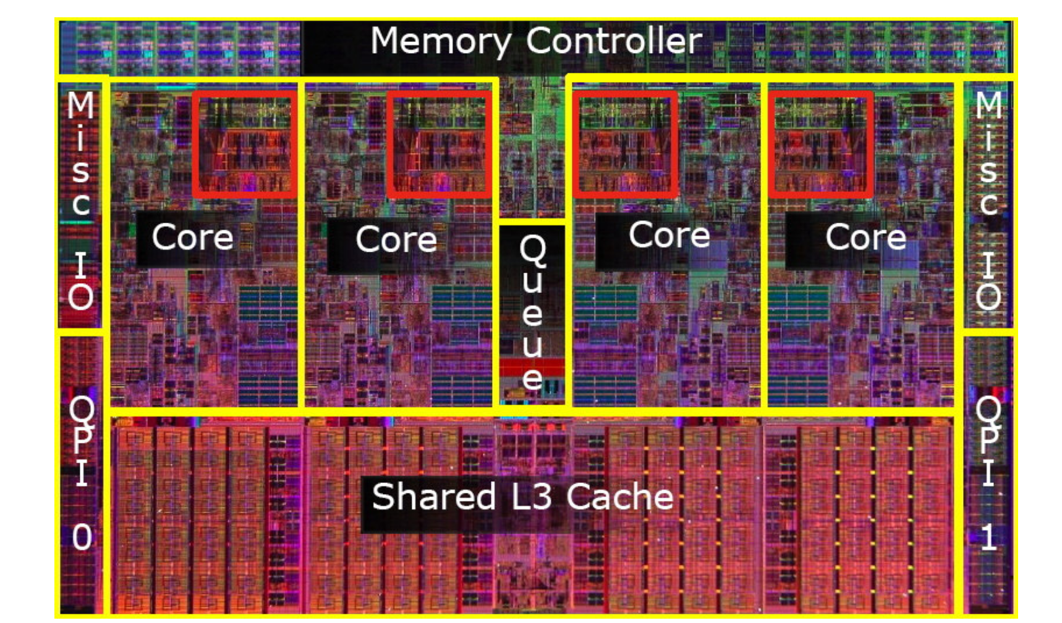
CPU’s are great But…
CPU cores continue to be optimized for single-threaded performance at the expense of parallel execution.
This fact is most apparent when one considers that integer and floating-point execution units occupy only a tiny fraction of the die area in a modern CPU.
[CPU Intel, Source: paper]

Slide 33
CPU’s are great But…
With such a small part of the chip devoted to performing direct calculations, it’s no surprise that CPUs are relatively inefficient for high-performance computing applications.
Most of the circuitry on a CPU, and therefore most of the heat it generates, is devoted to invisible complexity: those caches, instruction decoders, branch predictors, and other features that are not architecturally visible but which enhance single-threaded performance.

Slide 34
But I can try !
The Ideas was to increase the throughput via architectural innovations.
Speculation
Processor technology
Dual Issue processor

Slide 35
Intel’s Larrabee
Larrabee is Intel’s code name for a future graphics processing architecture based on the x86 architecture. The first Larrabee chip is said to use dual-issue cores derived from the original Pentium design, but modified to include support for 64-bit x86 operations and a new 512-bit vector-processing unit.

Slide 36
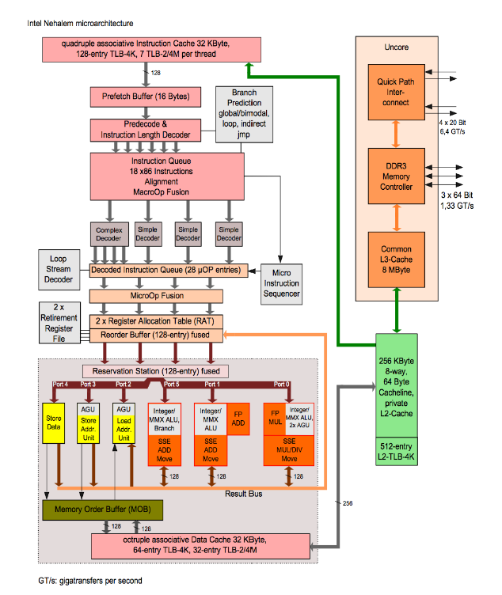
Intel’s Nehalem Architecture
Nehalem is the most sophisticated microarchitecture in any x86 processor. Its features are like a laundry list of high performance CPU design: four-wide superscalar, out of order, speculative execution, simultaneous multithreading, multiple branch predictors, on-die power gating, on-die memory controllers, large caches, and multiple interprocessor interconnects.

Slide 37
What we had so far…
Understanding the problem is half the solution

Slide 38
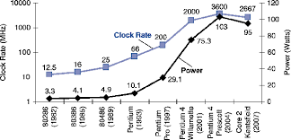
The Wall

Slide 39
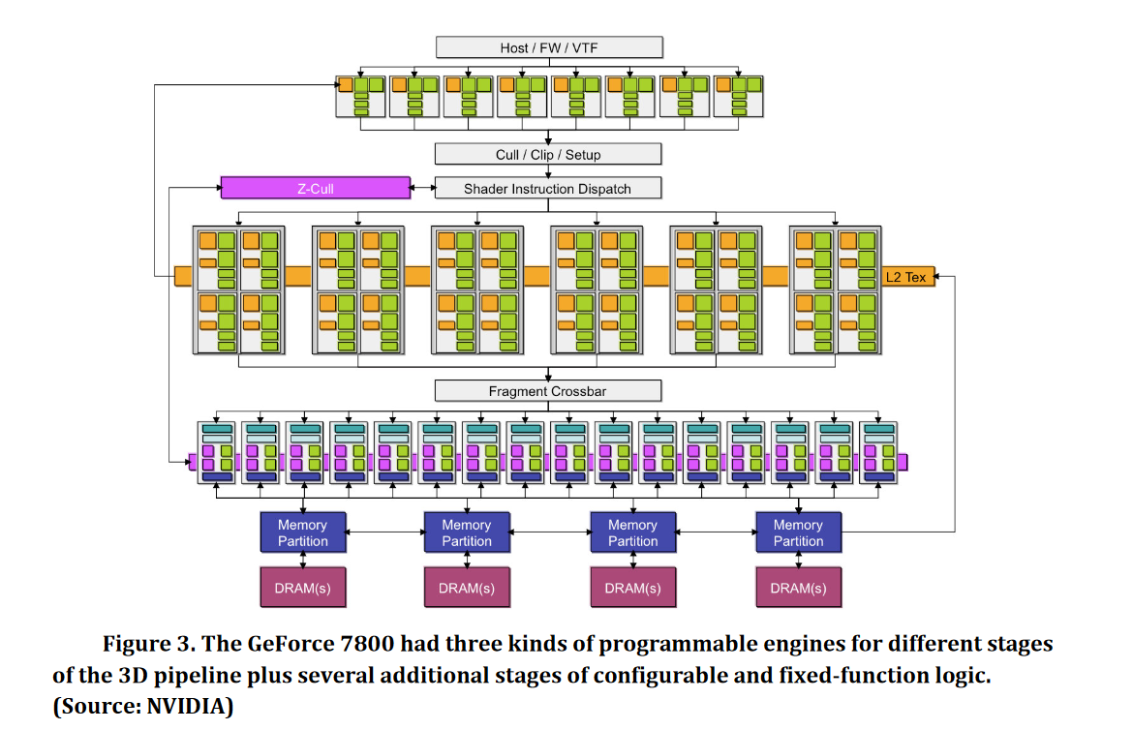
The History of the GPU
There were attempts to build chip-scale parallel processors in the 1990s, but the limited transistor budgets in those days favored more sophisticated single-core designs.
The real path toward GPU computing began, not with GPUs, but with non-programmable 3G-graphics accelerators.
[GeForce7000, Source: images]

Slide 40
The History of the GPU
NVIDIA’s GeForce 3 in 2001 introduced programmable pixel shading to the
consumer market. The programmability of this chip was very limited, but later
GeForce products became more flexible and faster, adding separate programmable engines for vertex and geometry shading. This evolution culminated in the GeForce 7800
[GeForce7000, Source: images]

Slide 41
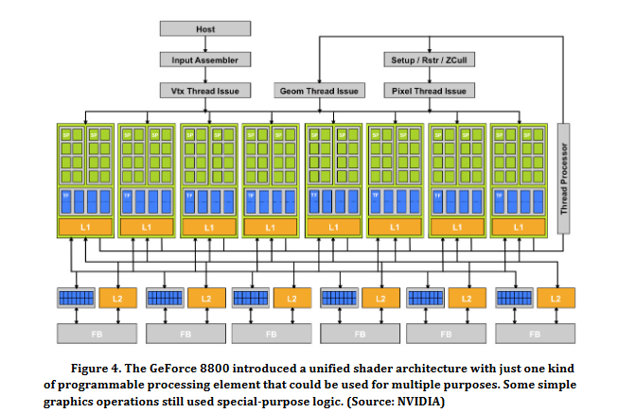
The History of the GPU

Slide 42
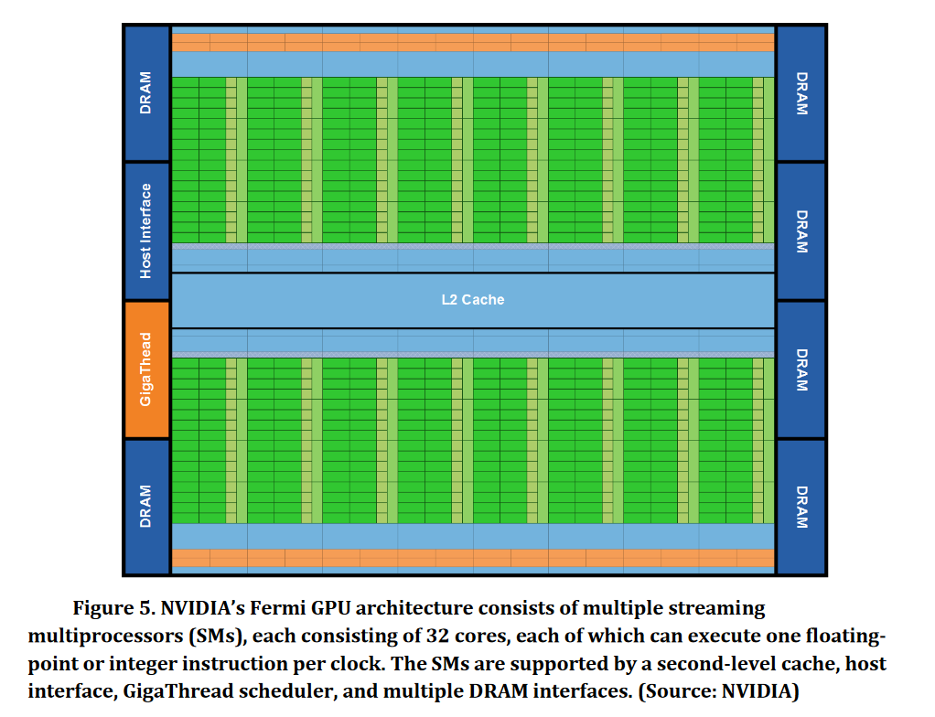
Introducing Fermi
GPU computing isn’t meant to replace CPU computing. Each approach has advantages for certain kinds of software. As explained earlier, CPUs are optimized for applications where most of the work is being done by a limited number of threads, especially where the threads exhibit high data locality, a mix of different operations, and a high percentage of conditional branches.

Slide 43
Introducing Fermi
GPU design aims at the other end of the spectrum: applications with multiple threads that are dominated by longer sequences of computational instructions. Over the last few years, GPUs have become much better at thread handling, data caching, virtual memory management, flow control, and other CPU-like features, but the distinction between computationally intensive software and control-flow intensive software is fundamental.
At this level of abstraction, the GPU looks like sea of computational units with only a few support elements—an illustration of the key GPU design goal, which is to maximize floating-point throughput.

Slide 44
Introducing Fermi
GPU design aims at the other end of the spectrum: applications with multiple threads that are dominated by longer sequences of computational instructions. Over the last few years, GPUs have become much better at thread handling, data caching, virtual memory management, flow control, and other CPU-like features, but the distinction between computationally intensive software and control-flow intensive software is fundamental.
At this level of abstraction, the GPU looks like sea of computational units with only a few support elements—an illustration of the key GPU design goal, which is to maximize floating-point throughput.

Slide 45
Introducing Fermi

Slide 46
The Programming Model (CUDA)
The complexity of the Fermi architecture is managed by a multi-level programming model that allows software developers to focus on algorithm design rather than the details of how to map the algorithm to the hardware, thus improving productivity. This is a concern that conventional CPUs have yet to address because their structures are simple and regular: a small number of cores presented as logical peers on a virtual bus.
the computational elements of algorithms are known as kernels(opencl and CUDA)
An application or library function may consist of one or more kernels
Once compiled, kernels consist of many threads that execute the same program in parallel: one thread is like one iteration of a loop.

Slide 47
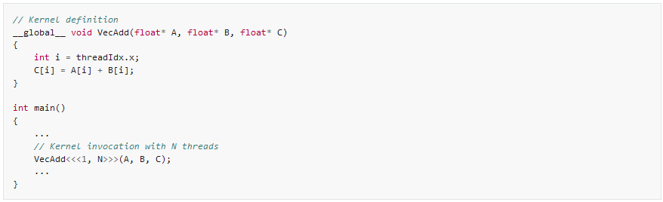
The Programming Model (CUDA)

Slide 48
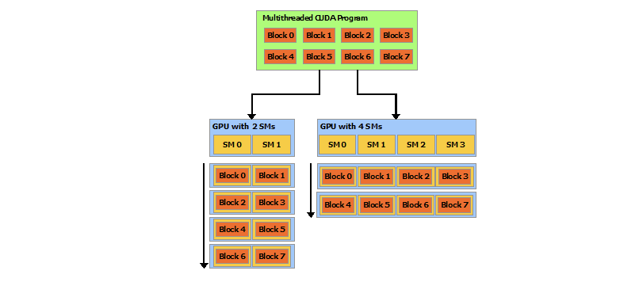
The Programming Model (CUDA)
Multiple threads are grouped into thread blocks containing up to 1,536 threads. All of the threads in a thread block will run on a single SM
Thread blocks can coordinate the use of global shared memory among themselves but may execute in any order, concurrently or sequentially.
https://docs.nvidia.com/cuda/cuda-c-programming-guide/index.html

Slide 49
The Programming Model (CUDA)
At any one time, the entire Fermi device is dedicated to a single application. As mentioned above, an application may include multiple kernels. Fermi supports simultaneous execution of multiple kernels from the same application, each kernel being distributed to one or more SMs on the device. This capability avoids the situation where a kernel is only able to use part of the device and the rest goes unused.
This switching is managed by the chip-level GigaThread hardware thread scheduler, which manages 1,536 simultaneously active threads for each streaming multiprocessor across 16 kernels.

Slide 50
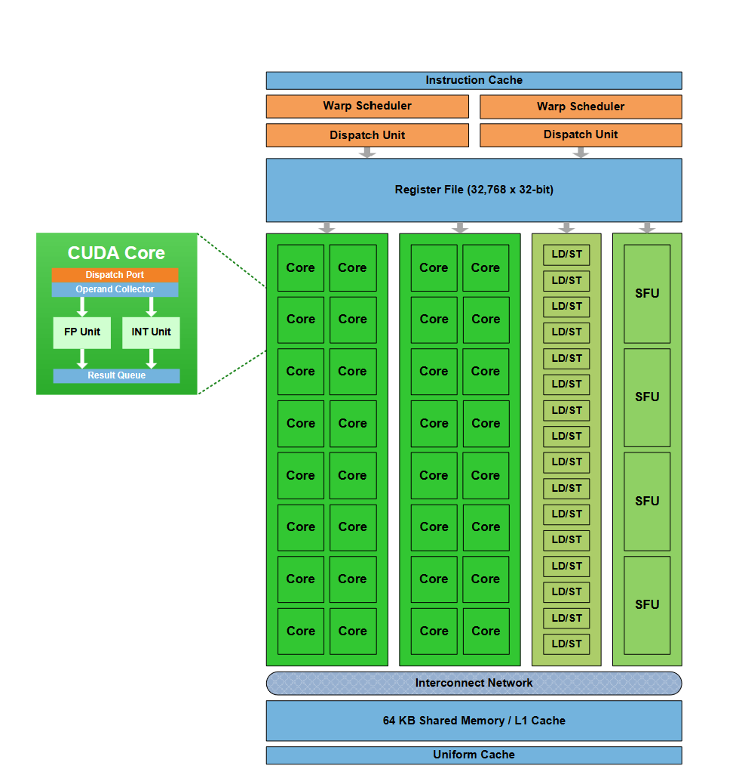
The Streaming Multiprocessor
Fermi’s streaming multiprocessors, shown in Figure 6, comprise 32 cores, each of which can perform floating-point and integer operations, along with 16 load-store units for memory operations, four special-function units, and 64K of local SRAM split between cache and local memory.

Slide 51
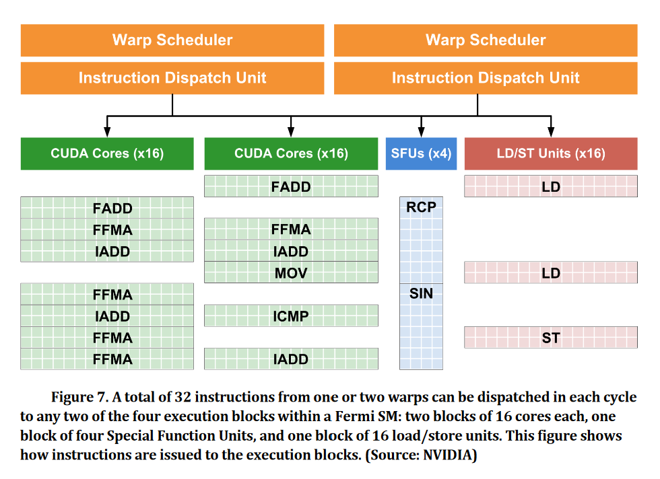
The Streaming Multiprocessor

Slide 52
Conclusion…

Slide 53
Thank You!

